Slide 1
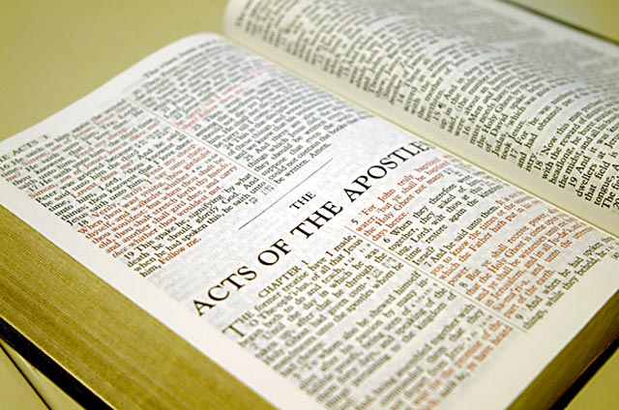
Public Scripture Reading
How to read God's Word aloud so people will really hear it!
Dr. Rick Griffith • Jordan Evangelical Theological Seminary • BibleStudyDownloads.org

Slide 2
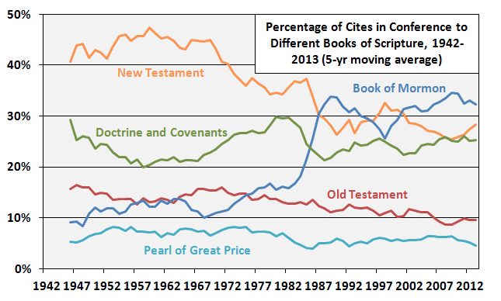
Mormons are reading The Book of Mormon more and the Bible less
Percentage of LDS Church Usage of Books Considered Scripture, 1942-2013 (5-yr moving average)
New Testament
Book of Mormon
Doctrine & Covenants
Old Testament
Pearl of Great Price
Adapted from http://zelophehadsdaughters.com/ at 10 July 2014
Notes:
“Finally, I did one more adjustment to account for the norms of how often the different books of scripture are cited in Conference by all speakers during the years each Quorum member served. What I mean here is that at different points in time, different books of scripture were cited more or less by all speakers in Conference. Because members have been in the Quorum for different amounts of time, some of the differences between them can be accounted for by the different norms in Conference at the times they were giving talks.
The biggest shift in the time current Quorum members have served has been an increase in citations of the Book of Mormon. Here’s a graph showing the percentage of all citations of scriptures in Conference that came from each of the five books of scripture since 1942 (as far back as the LDSSCI has Conference talk data).”
Ziff, “Which GAs Prefer Which Books of Scripture?” at http://zelophehadsdaughters.com/ posted 10 July 2014 (accessed 12 Aug 2014)

Slide 3
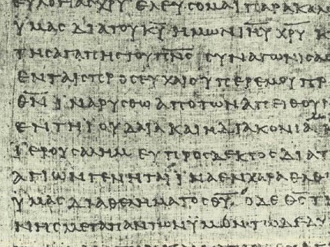
The most important part of your sermon…
9
…is the only thing that the audience hears as the actual Word of God!

Slide 4
So how can we read Scripture properly?
9
Let's look at some problems and solutions…

Slide 5
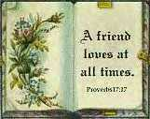
A. Too often the Scripture reading has nothing to do with the message of the morning.
9
So make sure they relate!

Slide 6
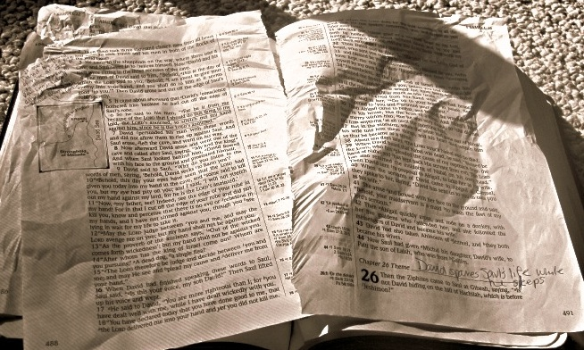
B. We introduce the reference poorly so people have to ask one another where we are.
9
So in the introduction always announce your text three times for those who did not catch it initially.

Slide 7
C. We begin reading before people have a chance to find the passage.
9
So wait until you hear the pages stop turning before reading the text.

Slide 8
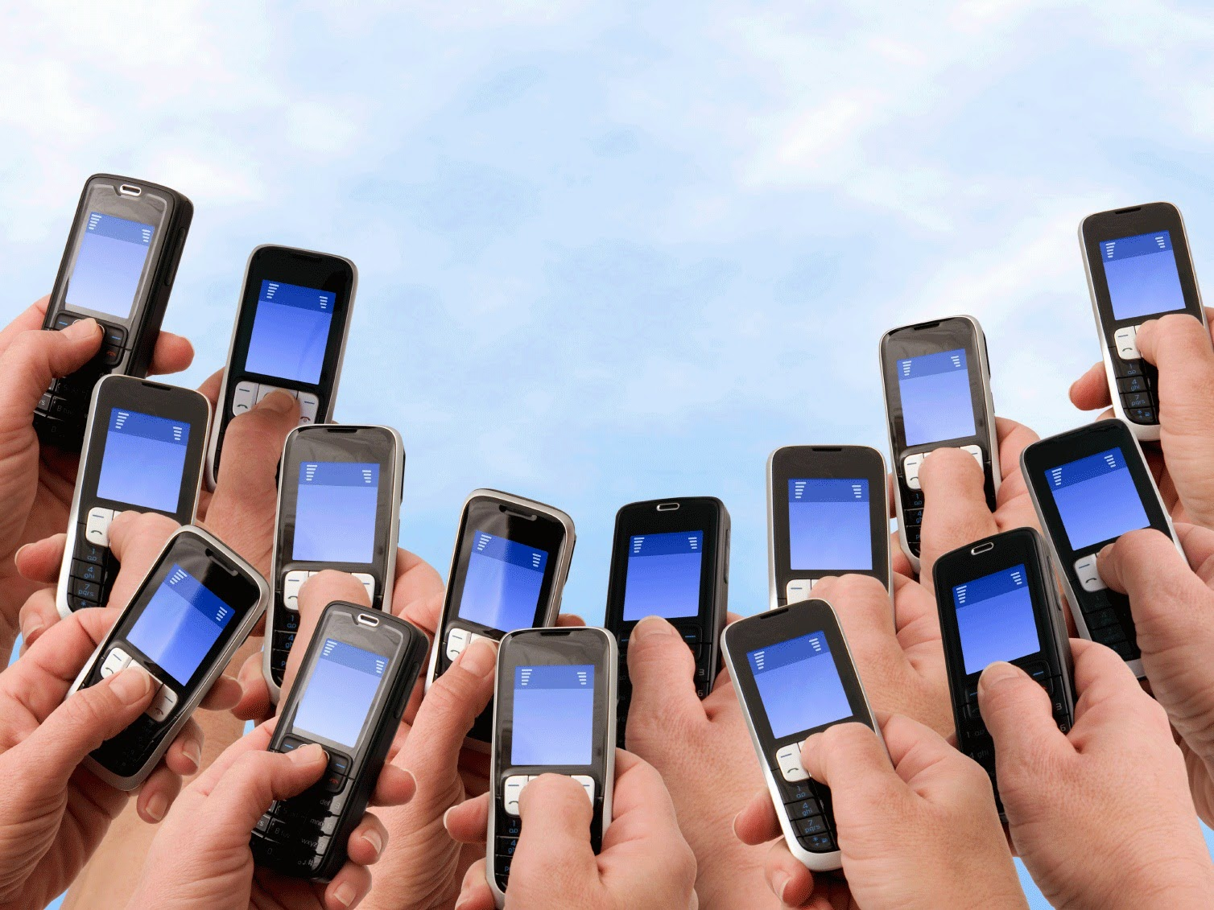
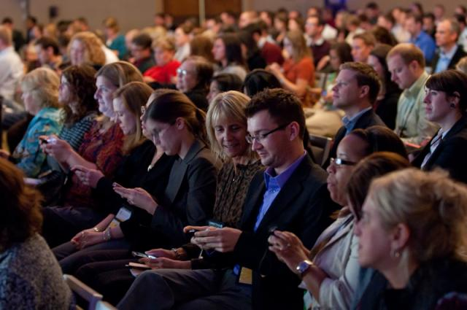
How will you know when they found the text on their smartphone?
9

Slide 9
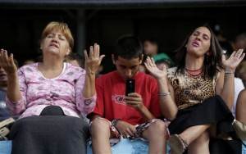
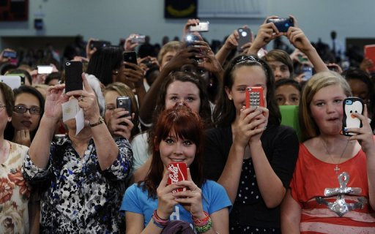
How will you know when they found the text on their smartphone?
9
Ask them to look up at you!

Slide 10
D. We don't give needed background information to understand the text (e.g., no context to start reading at Acts 14:21).
9
So provide the needed context even before announcing your text.

Slide 11
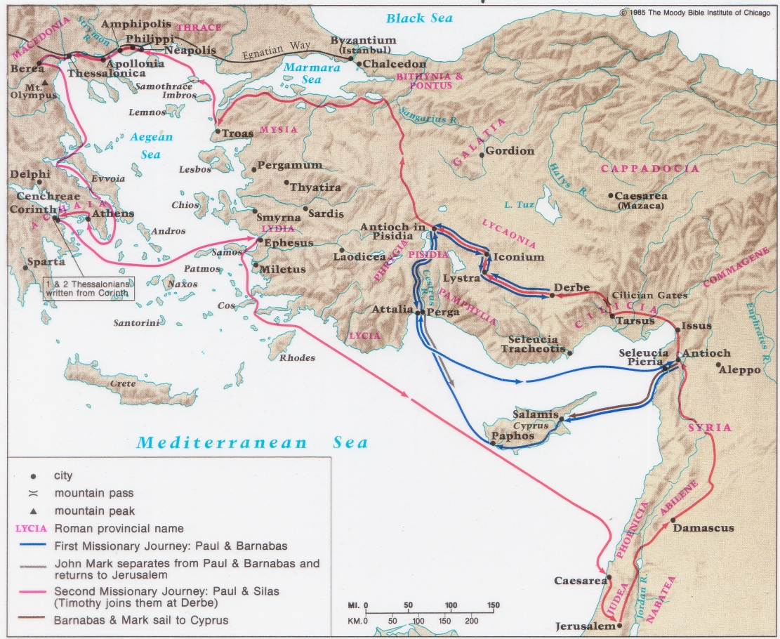
First Missionary Journey
of Paul & Barnabas (Acts 13–14)

Slide 12
E. Difficult words are sometimes mispronounced due to lack of preparation.
9
So use The Book of Life guide at the back of the notes to pronounce names correctly (pp. 226-244)

Slide 13
F. We emphasize the wrong words.
9
(Accent "gave," not "for," in Gal. 2:20).
“I have been crucified with Christ and I no longer live, but Christ lives in me. The life I now live in the body, I live by faith in the Son of God, who loved me and gave himself for me” (Gal. 2:20 NIV).

Slide 14
F. We emphasize the wrong words.
9
(Accent "me," not "before," in Exod. 20:3).
“You shall have no other gods before me” (Exod. 20:3 NIV).

Slide 15
F. We emphasize the wrong words.
9
So practice which words to emphasize and read the text aloud so many times that you almost have it memorized.

Slide 16
G. The passage is often read with a flat tone of voice.
9
So vary your speed of speaking and volume. Read to children—they're merciless!

Slide 17
H. It's hard to teach people to read well who have a "I already know how to read" attitude.
9
So select 5 people at church who are good readers and give them this mini-seminar.

Slide 18
I. We feel we always have to end every reading with the trite cliché, "May God add His blessing to the reading of His Word."
9
If we read the Bible well, it will already be a blessing without us having to bless it.

Slide 19
Scripture Readings
9
A. Narrative: Triumphal Entry (Mark 11:1-11)
Prophecy: Heaven's Throne (Revelation 4:1-11)
Lament: Petitioning Help (Psalm 70)
Notes:
Have three volunteers read one of these passages and then ask the class to critique them after each time.

Slide 20
Black

Slide 21
Preaching (Homiletics) link at BibleStudyDownloads.org
Get this presentation for free!
Notes:
Preaching (pr)
Homiletics

